Slide 1


Slide 2
Intro.

Slide 3
Software Design Patterns

Slide 4
The MV Family
Designed for user interfaces
Decouples major components
More efficient code reuse
Parallel development
Derivatives
MVC
MVA
MVVM
MVP
MV*

Slide 5
MVC
Model: Application data, logic & rules
View: Representation of data
Controller: Sends commands to a view/model in response to input
Well defined roles
Decoupling of responsibility throughout the code

Slide 6
MV Family Problems
Increased application size, increased complexity
More models & views, interacting components
Intertwining duplex connections
Difficult to trace – no patterns, constraints or guarantees
Fragile code – cascading effects or nested updates
Code becomes harder to manage, understand and reason about
No consistency between projects

Slide 7
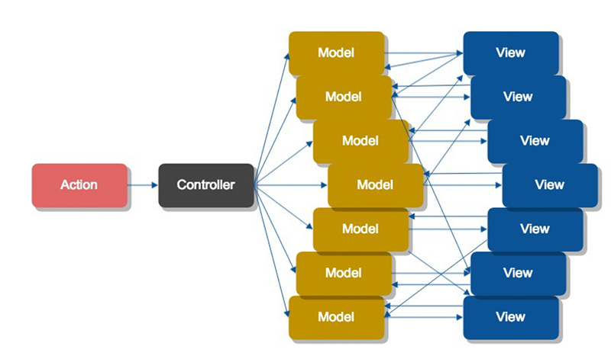

Slide 8
Flux
Uni-directional data flow
Remove duplex connections from the system
Delegate all connections to a single central location
Avoid cascading effects and nested updates
Flow is much more easily traced in a single direction
Flow has constraint, guarantee and consistency
Code becomes more robust, manageable and easier to reason about

Slide 9

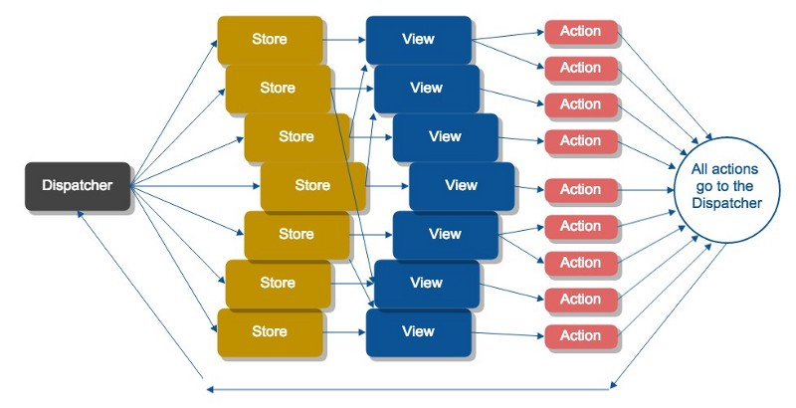

Slide 10
Tech Stack

Slide 11
SPA Framework
Angular
Why?
Core features and abstractions
Design patterns
Testing
Documentation
Community
Active development
Performance
Cross runtime portability

Slide 12
Reactive Programming
Rxjs
Why?
Angular change detection
Design patterns
“The Observer done right”
Asynchronous programming with observable streams
Purely functional
Treat streams of asynchronous events as arrays using simple, composable operations

Slide 13
Flux Implementation
Ngrx
Why?
Built using Angular and Rxjs
Design Patterns
“The Angular Way”
Reactive programming
No wrappers
No plugins

Slide 14
ngrx

Slide 15
Actions
Payload of information sent to the store from the application
Created in response to events
User interactions
Server actions
Timers/timeouts
Action creators: pure functions which return an action to dispatch
interface IAction {
type: string;
payload: any;
}

Slide 16
Reducers
Specify how an application’s state changes in response to actions
A reducer
Is a pure function
Receives the previous state and an action as parameters
Returns the next state
Should never:
Mutate arguments
Perform side effects
Interact with non-pure functions

Slide 17
Store
Holds application state
Provides access to application state through subscriptions
store.select();
Allows state to be updated through dispatched actions
store.dispatch();
Consists of reducers
StoreModule.provideStore({ appState: AppReducer })

Slide 18
Angular

Slide 19
Components
Consists of both a view, and a view controller
import { Component } from '@angular/core';
@Component({
selector: ‘my-component',
template: require('./my.component.html')
})
export class MyComponent {
}

Slide 20
Services
Reusable, sharable and injectable
import { Injectable } from '@angular/core';
@Injectable()
export class SomeService {
}

Slide 21
Presentation Components
Also called pure/dumb
Mainly presentation logic
No business logic
Receive data
Emit events
Don’t know where data comes from
Or what happens when an event is emitted

Slide 22
Controller Components
Also called application-level/container/smart
Not much presentation logic
Primarily business logic
Use Store Services to receive data and react to events
Inject data into Dumb Components
React to events emitted from Dumb Components

Slide 23
Store Service
Act as an entry point to the Store
Subscribe to data from the Store
Expose subscribed data to Smart Components
React to events on Smart Components
Use Action Creator Services to dispatch events to the Store

Slide 24
Action Creator Service
Expose type-safe Action types
Action creator for each Action type

Slide 25
Demo Application

Slide 26
Code Examples

Slide 27
Todo Model src/modules/todo/todo.model.ts
export interface ITodo {
id: number;
text: string;
completed: boolean;
}
export class Todo implements ITodo {
public id: number;
public completed: boolean = false;
constructor(public text: string) { }
}

Slide 28
Todo State src/modules/todo/todo.state.ts
import { Todo } from './todo.model';
export interface ITodoState {
todos: Array<Todo>;
}
export const InitialTodoState: ITodoState = {
todos: new Array<Todo>()
};

Slide 29
Todo Actions (Action Creator Service) src/modules/todo/todo.actions.ts
import { Injectable } from '@angular/core';
import { Action } from '@ngrx/store';
import { Todo } from './todo.model';
export interface ITodoActionPayload {
todo?: Todo;
todoId?: number;
}
export interface ITodoAction extends Action {
payload: ITodoActionPayload;
}

Slide 30
Todo Actions (Action Creator Service) src/modules/todo/todo.actions.ts
@Injectable()
export class TodoActions {
public static ADD_TODO: string = 'ADD_TODO';
public addTodo(todo: Todo): ITodoAction {
return {
type: TodoActions.ADD_TODO,
payload: { todo }
};
}
}

Slide 31
Todo Service (Store Service) src/modules/todo/todo.service.ts
import { Injectable } from '@angular/core';
import { Store } from '@ngrx/store';
import { Observable } from 'rxjs/Observable';
import { Todo } from './todo.model';
import { TodoActions } from './todo.actions';
import { ITodoState } from './todo.state';

Slide 32
Todo Service (Store Service) src/modules/todo/todo.service.ts
@Injectable()
export class TodoService {
public todos$: Observable<Todos>;
constructor(
private actions: TodoActions,
private store: Store<ITodoState>
) {
this.todos$ = store.select(((state: ITodoState) => state.todos));
}
public addTodo(text: string): void {
this.store.dispatch(this.actions.addTodo(new Todo(text)));
}
}

Slide 33
Todo Reducer src/modules/todo/todo.reducer.ts
import { ActionReducer } from '@ngrx/store';
import { Todo } from './todo.model';
import { ITodoState, InitialTodoState } from './todo.state';
import { ITodoAction, TodoActions } from './todo.actions';
let prevTodoId: number = 0;

Slide 34
Todo Reducer src/modules/todo/todo.reducer.ts
export const TodoReducer: ActionReducer<ITodoState> =
(state: ITodoState = InitialTodoState, action: ITodoAction) => {
switch (action.type) {
case TodoActions.ADD_TODO:
return {
todos: state.todos.concat(
[Object.assign({}, action.payload.todo, { id: prevTodoId++ })]
)
};
default:
return state;
}

Slide 35
Todo Module src/modules/todo/todo.module.ts
import { NgModule } from '@angular/core';
import { TodoActions } from './todo.actions';
import { TodoService } from './todo.service';
@NgModule({
providers: [TodoService, TodoActions],
exports: [TodoService, TodoActions]
})
export class TodoModule { }

Slide 36
Todo Form Component (Presentation) src/modules/todo-form/todo-form.component.html
<form (ngSubmit)="submit()">
<input [(ngModel)]="text" type="text">
</form>

Slide 37
Todo Form Component (Presentation) src/modules/todo-form/todo-form.component.ts
import { Component, EventEmitter, Output } from '@angular/core';
@Component({
selector: 'amd-todo-form',
template: require('./todo-form.component.html')
})
export class TodoFormComponent {
@Output() public addTodo: EventEmitter<string> = new EventEmitter();
public text: string = '';
public submit = () => {
this.addTodo.emit(this.text);
}
}

Slide 38
Todo Form Module src/modules/todo-form/todo-form.module.ts
import { NgModule } from '@angular/core';
import { FormsModule } from '@angular/forms';
import { TodoFormComponent } from './todo-form.component';
@NgModule({
imports: [FormsModule],
exports: [TodoFormComponent],
declarations: [TodoFormComponent]
})
export class TodoFormModule { }

Slide 39
Todo List Component (Presentation) src/modules/todo-list/todo-list.component.html
<amd-todo-item
*ngFor="let todo of todos | async"
[todo]="todo"
</amd-todo-item>

Slide 40
Todo List Component (Presentation) src/modules/todo-list/todo-list.component.ts
import { Component, Input, Output, } from '@angular/core';
import { Observable } from 'rxjs/Observable';
import { Todo } from '../todo';
@Component({
selector: 'amd-todo-list',
template: require('./todo-list.component.html')
}) export class TodoListComponent {
@Input() public todos: Observable<Array<Todo>>;
}

Slide 41
Todo List Module src/modules/todo-list/todo-list.module.ts
import { NgModule } from '@angular/core'; import { TodoFormComponent } from './todo-form.component';
@NgModule({
exports: [TodoFormComponent],
declarations: [TodoFormComponent]
})
export class TodoFormModule { }

Slide 42
App Component (Controller) src/modules/app/app.component.html
<amd-todo-form (addTodo)="addTodo($event)">
</amd-todo-form>
<amd-todo-list [todos]="todos">
</amd-todo-list>

Slide 43
App Component (Controller) src/modules/app/app.component.ts
import { Component, OnInit } from '@angular/core';
import { Observable } from 'rxjs';
import { TodoService, Todo } from '../todo';
@Component({
selector: 'amd-app',
template: require('./app.component.html')
})
export class AppComponent implements OnInit {
public todos: Observable<Array<Todo>>;
constructor(public todoService: TodoService) { }
public ngOnInit(): void {
this.todos = this.todoService.todos$;
}
public addTodo = (event: any) => {
this.todoService.addTodo(event);
} }

Slide 44
App Module src/modules/app/app.module.ts
import { NgModule } from '@angular/core'
import { BrowserModule } from '@angular/platform-browser';
import { StoreModule } from '@ngrx/store';
import { TodoReducer, TodoModule } from '../todo';
import { TodoFormModule } from '../todo-form';
import { TodoListModule } from '../todo-list';
@NgModule({
imports: [
BrowserModule, TodoModule, TodoFormModule, TodoListModule,
StoreModule.provideStore({ todoState: TodoReducer })
]
})
export class AppModule { }

Slide 45
Demo Dev Tools

Slide 46
About Me
Name: Nathan Mc Grath
Occupation: Final Year Student of Applied Computing
Email: contact@nathan-mcgrath.com
Website: http://nathan-mcgrath.com
Twitter: @AniMunDev

Slide 47
Questions?

